Slide 1
Detecting Viral Protein Sequences within Tumor Genome Copy Number Amplifications
Mary Piaskowski and Tristan Neal
Laboratory of Cellular Oncology NCI/CCR
Starrett Lab

Slide 2
Background: How are oncogenic viruses causing CNVs?
Model 1: Viral genome integration and rolling circle amplification

Slide 3
Hypothesis
Binding by the replicative proteins of oncogenic viruses promotes amplification of genes
These genes should be observable as copy number variations (CNVs) containing putative viral protein binding motifs in tumor genome sequencing.

Slide 4
Methods Part 1: Extracting Small CNVs from Tumor Genomes
Input
Extract sequences from human refence genome as a dataframe
Isolate small CNV amplifications (<0.5mil bp)
CNV
+
CNVs from bladder cancer

Slide 5
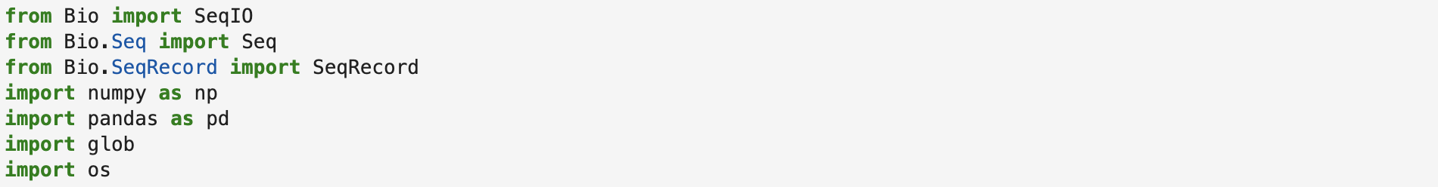
Code: Extracting Small CNVs (Mary Piaskowski)

Slide 6
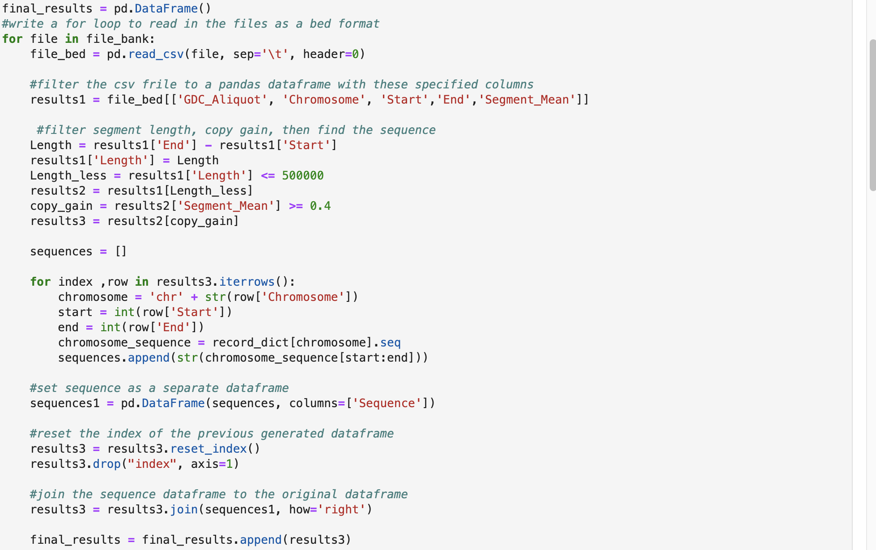
Code: Extracting Small CNVs (Mary Piaskowski)

Slide 7
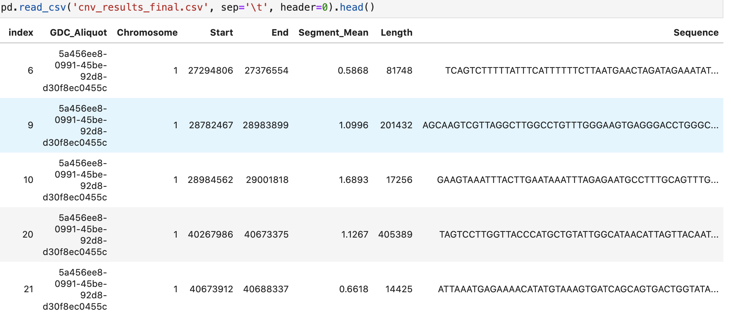
Code: Extracting Small CNVs (Mary Piaskowski)

Slide 8
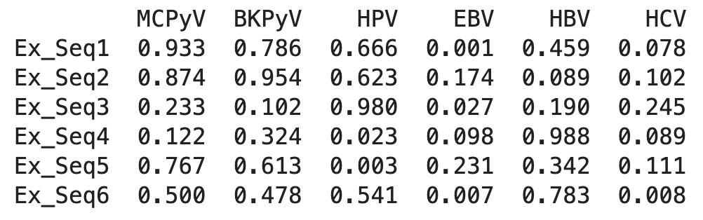
Methods Part 2: Detecting Sequence Matches + Calculating Virus Binding Score
Extracted
Small CNVs
Calculate virus binding score
Calculate significance versus control
Output
Known viral protein DNA-binding motifs
Build and validate scoring system
Train on viral genomes
(+ control)
Train on non-viral sequences
(- control)

Slide 9
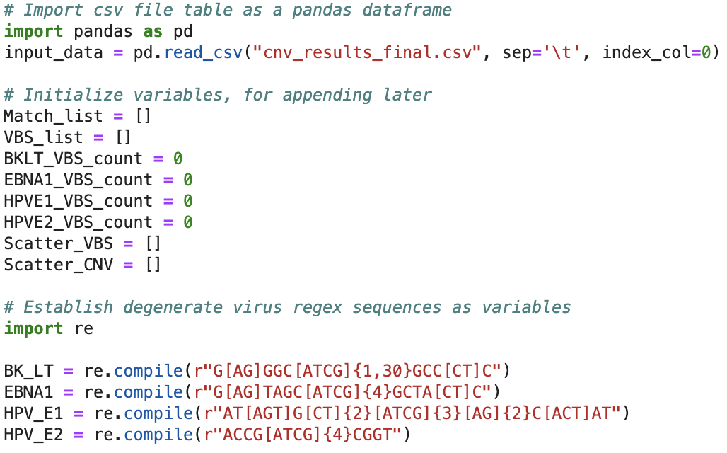
# Import csv file table as a pandas dataframe
import pandas as pd
input_data = pd.read_csv("filename.csv",index_col=0)
# Initialize variables, for appending later
Match_list = []
VBS_list = []
BKLT_VBS_count = 0
EBNA1_VBS_count = 0
HPVE1_VBS_count = 0
HPVE2_VBS_count = 0
Scatter_VBS = []
Scatter_CNV - []
# Establish degenerate virus regex sequences as variables
import re
BK_LT = re.compile(r"G[AG]GGC[ATCG]{1:30}GCC[CT]C")
EBNA1 = re.compile(r"G[AG]TAGC[ATCG]{4}GCTA[CT]C")
HPV_E1 = re.compile(r"AT[AGT]G[CT]{2}[ATCG]{3}[AG]{2}C[ACT]AT")
HPV_E2 = re.compile(r"ACCG[ATCG]{4}CGGT")
# Find virus sequences in input_sequence with re.finditer
for CNV, col in input_data.iterrows():
#Reset list of CNV VBSs for each new CNV and label with new CNV name
CNV_VBS = [col["GDC Aliquot"]]
#Reset VBS counts for each new CNV
BKLT_VBS_count = 0
EBNA1_VBS_count = 0
HPVE1_VBS_count = 0
HPVE2_VBS_count = 0
BK_iter = BK_LT.finditer(col["Sequence"])
if BK_iter:
for match in BK_iter:
#Assembling match list
temp_match_list = []
temp_match_list.append(col["GDC Aliquot"])
temp_match_list.append("BK Polyomavirus Large T Anitgen")
temp_match_list.append(match.start()+1)
temp_match_list.append(match.end()+1)
temp_match_list.append(match.group())
Match_list.append(temp_match_list)
#Adding 1 to numerator of VBS count for each CNV every time a match is found
BKLT_VBS_count += 1
#Adding total BK VBS to list of VBSs for this CNV
CNV_VBS.append(BKLT_VBS_count/(col["Length"]/1000))
#Adding VBS values to lists for scatter plot
Scatter_VBS.append(BKLT_VBS_count/(col["Length"]/1000))
Scatter_CNV.append(col["Segment Mean"])
EBNA1_iter = EBNA1.finditer(col["Sequence"])
if EBNA1_iter:
for match in EBNA1_iter:
HPVE1_iter = HPV_E1.finditer(col["Sequence"])
if HPVE1_iter:
for match in HPVE1_iter:
HPVE2_iter = HPV_E2.finditer(col["Sequence"])
if HPVE2_iter:
for match in HPVE2_iter:
#Adding list of all VBSs for this CNV to the list of lists
VBS_list.append(CNV_VBS)
# Turn list of lists into pandas dataframes
CNV_virus_match_table = pd.DataFrame(Match_list, columns=["CNV ID","Viral Protein","Loci Start", "Loci End", "Viral Sequence"])
CNV_virus_match_table.style.set_caption("Viral Protein Sequences within Copy Number Variation Sequences")
CNV_virus_match_table.to_csv('Summary_of_CNV_virus_matches.csv')
VBS_table = pd.DataFrame(VBS_list, columns=["CNV ID", "BKPyV LT", "EBNA1", "HPV E1", "HPV E2"])
VBS_table.style.set_caption("Virus Binding Scores")
# Print out scatter plot
plt.scatter(Scatter_CNV, Scatter_VBS)
plt.title("Virus Binding Score Correlates to CNV Intensity")
plt.xlabel("CNV Intensity")
plt.ylabel("Virus Binding Score")
plt.show()
Code: Detecting Matches + Calculating VBS (Tristan Neal)

Slide 10
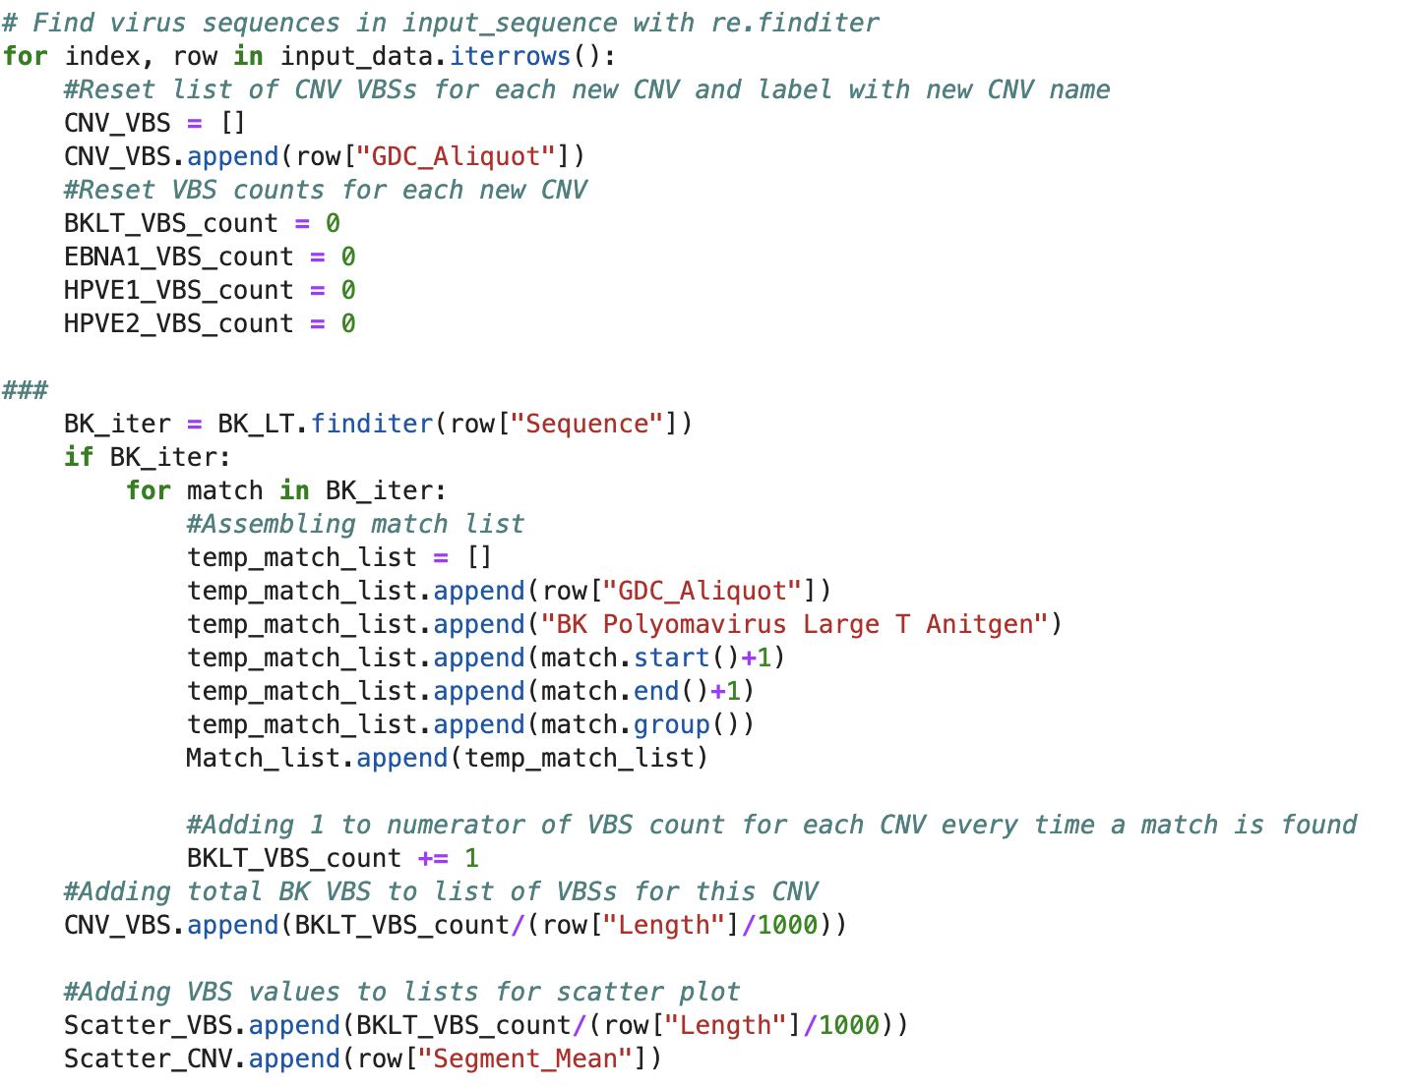
# Import csv file table as a pandas dataframe
import pandas as pd
input_data = pd.read_csv("filename.csv",index_col=0)
# Initialize variables, for appending later
Match_list = []
VBS_list = []
BKLT_VBS_count = 0
EBNA1_VBS_count = 0
HPVE1_VBS_count = 0
HPVE2_VBS_count = 0
Scatter_VBS = []
Scatter_CNV - []
# Establish degenerate virus regex sequences as variables
import re
BK_LT = re.compile(r"G[AG]GGC[ATCG]{1:30}GCC[CT]C")
EBNA1 = re.compile(r"G[AG]TAGC[ATCG]{4}GCTA[CT]C")
HPV_E1 = re.compile(r"AT[AGT]G[CT]{2}[ATCG]{3}[AG]{2}C[ACT]AT")
HPV_E2 = re.compile(r"ACCG[ATCG]{4}CGGT")
# Find virus sequences in input_sequence with re.finditer
for CNV, col in input_data.iterrows():
#Reset list of CNV VBSs for each new CNV and label with new CNV name
CNV_VBS = [col["GDC Aliquot"]]
#Reset VBS counts for each new CNV
BKLT_VBS_count = 0
EBNA1_VBS_count = 0
HPVE1_VBS_count = 0
HPVE2_VBS_count = 0
BK_iter = BK_LT.finditer(col["Sequence"])
if BK_iter:
for match in BK_iter:
#Assembling match list
temp_match_list = []
temp_match_list.append(col["GDC Aliquot"])
temp_match_list.append("BK Polyomavirus Large T Anitgen")
temp_match_list.append(match.start()+1)
temp_match_list.append(match.end()+1)
temp_match_list.append(match.group())
Match_list.append(temp_match_list)
#Adding 1 to numerator of VBS count for each CNV every time a match is found
BKLT_VBS_count += 1
#Adding total BK VBS to list of VBSs for this CNV
CNV_VBS.append(BKLT_VBS_count/(col["Length"]/1000))
#Adding VBS values to lists for scatter plot
Scatter_VBS.append(BKLT_VBS_count/(col["Length"]/1000))
Scatter_CNV.append(col["Segment Mean"])
EBNA1_iter = EBNA1.finditer(col["Sequence"])
if EBNA1_iter:
for match in EBNA1_iter:
HPVE1_iter = HPV_E1.finditer(col["Sequence"])
if HPVE1_iter:
for match in HPVE1_iter:
HPVE2_iter = HPV_E2.finditer(col["Sequence"])
if HPVE2_iter:
for match in HPVE2_iter:
#Adding list of all VBSs for this CNV to the list of lists
VBS_list.append(CNV_VBS)
# Turn list of lists into pandas dataframes
CNV_virus_match_table = pd.DataFrame(Match_list, columns=["CNV ID","Viral Protein","Loci Start", "Loci End", "Viral Sequence"])
CNV_virus_match_table.style.set_caption("Viral Protein Sequences within Copy Number Variation Sequences")
CNV_virus_match_table.to_csv('Summary_of_CNV_virus_matches.csv')
VBS_table = pd.DataFrame(VBS_list, columns=["CNV ID", "BKPyV LT", "EBNA1", "HPV E1", "HPV E2"])
VBS_table.style.set_caption("Virus Binding Scores")
# Print out scatter plot
plt.scatter(Scatter_CNV, Scatter_VBS)
plt.title("Virus Binding Score Correlates to CNV Intensity")
plt.xlabel("CNV Intensity")
plt.ylabel("Virus Binding Score")
plt.show()
Code: Detecting Matches + Calculating VBS (Tristan Neal)

Slide 11
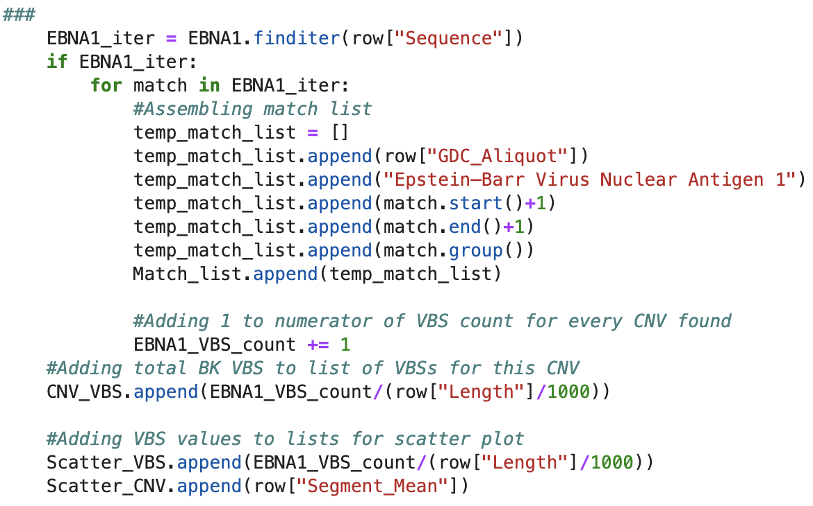
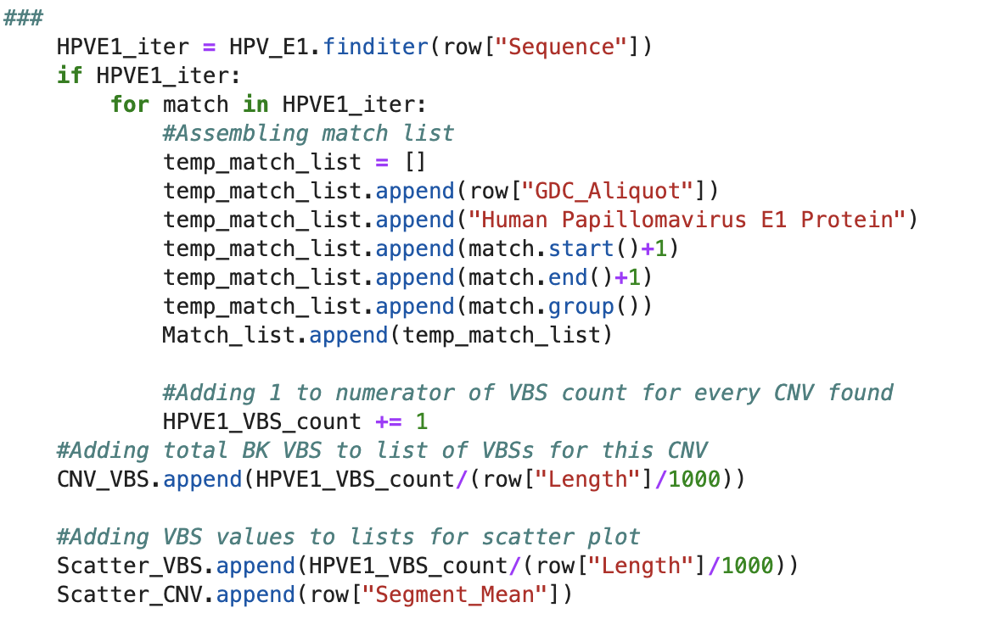
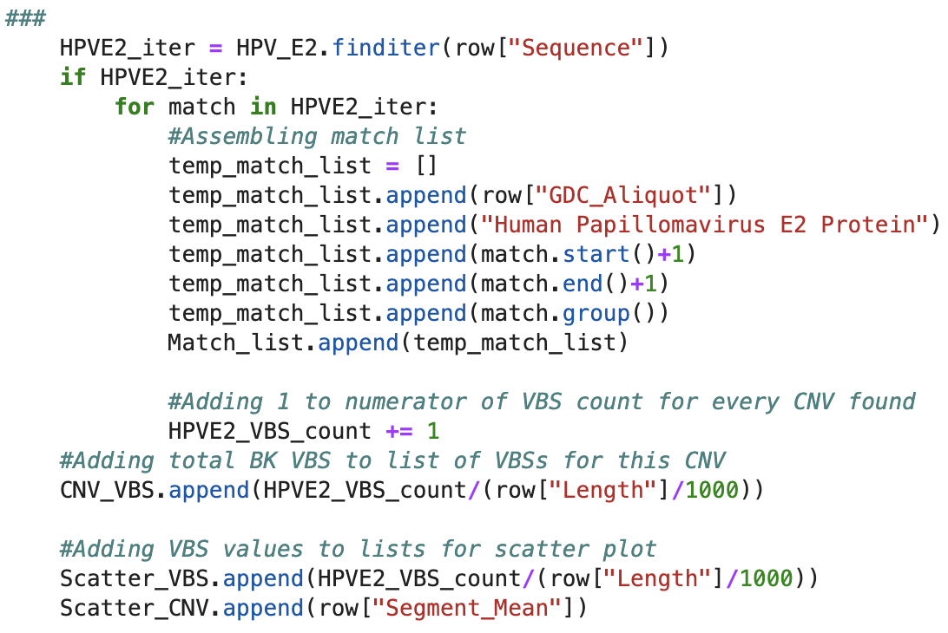
# Import csv file table as a pandas dataframe
import pandas as pd
input_data = pd.read_csv("filename.csv",index_col=0)
# Initialize variables, for appending later
Match_list = []
VBS_list = []
BKLT_VBS_count = 0
EBNA1_VBS_count = 0
HPVE1_VBS_count = 0
HPVE2_VBS_count = 0
Scatter_VBS = []
Scatter_CNV - []
# Establish degenerate virus regex sequences as variables
import re
BK_LT = re.compile(r"G[AG]GGC[ATCG]{1:30}GCC[CT]C")
EBNA1 = re.compile(r"G[AG]TAGC[ATCG]{4}GCTA[CT]C")
HPV_E1 = re.compile(r"AT[AGT]G[CT]{2}[ATCG]{3}[AG]{2}C[ACT]AT")
HPV_E2 = re.compile(r"ACCG[ATCG]{4}CGGT")
# Find virus sequences in input_sequence with re.finditer
for CNV, col in input_data.iterrows():
#Reset list of CNV VBSs for each new CNV and label with new CNV name
CNV_VBS = [col["GDC Aliquot"]]
#Reset VBS counts for each new CNV
BKLT_VBS_count = 0
EBNA1_VBS_count = 0
HPVE1_VBS_count = 0
HPVE2_VBS_count = 0
BK_iter = BK_LT.finditer(col["Sequence"])
if BK_iter:
for match in BK_iter:
#Assembling match list
temp_match_list = []
temp_match_list.append(col["GDC Aliquot"])
temp_match_list.append("BK Polyomavirus Large T Anitgen")
temp_match_list.append(match.start()+1)
temp_match_list.append(match.end()+1)
temp_match_list.append(match.group())
Match_list.append(temp_match_list)
#Adding 1 to numerator of VBS count for each CNV every time a match is found
BKLT_VBS_count += 1
#Adding total BK VBS to list of VBSs for this CNV
CNV_VBS.append(BKLT_VBS_count/(col["Length"]/1000))
#Adding VBS values to lists for scatter plot
Scatter_VBS.append(BKLT_VBS_count/(col["Length"]/1000))
Scatter_CNV.append(col["Segment Mean"])
EBNA1_iter = EBNA1.finditer(col["Sequence"])
if EBNA1_iter:
for match in EBNA1_iter:
HPVE1_iter = HPV_E1.finditer(col["Sequence"])
if HPVE1_iter:
for match in HPVE1_iter:
HPVE2_iter = HPV_E2.finditer(col["Sequence"])
if HPVE2_iter:
for match in HPVE2_iter:
#Adding list of all VBSs for this CNV to the list of lists
VBS_list.append(CNV_VBS)
# Turn list of lists into pandas dataframes
CNV_virus_match_table = pd.DataFrame(Match_list, columns=["CNV ID","Viral Protein","Loci Start", "Loci End", "Viral Sequence"])
CNV_virus_match_table.style.set_caption("Viral Protein Sequences within Copy Number Variation Sequences")
CNV_virus_match_table.to_csv('Summary_of_CNV_virus_matches.csv')
VBS_table = pd.DataFrame(VBS_list, columns=["CNV ID", "BKPyV LT", "EBNA1", "HPV E1", "HPV E2"])
VBS_table.style.set_caption("Virus Binding Scores")
# Print out scatter plot
plt.scatter(Scatter_CNV, Scatter_VBS)
plt.title("Virus Binding Score Correlates to CNV Intensity")
plt.xlabel("CNV Intensity")
plt.ylabel("Virus Binding Score")
plt.show()
Code: Detecting Matches + Calculating VBS (Tristan Neal)

Slide 12
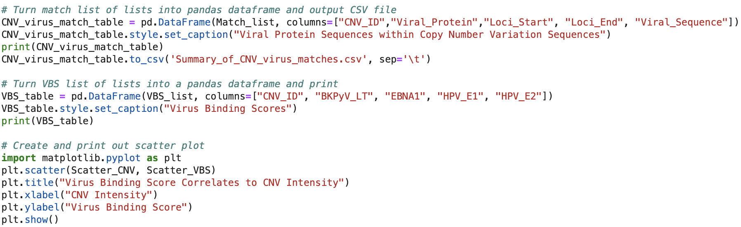
# Import csv file table as a pandas dataframe
import pandas as pd
input_data = pd.read_csv("filename.csv",index_col=0)
# Initialize variables, for appending later
Match_list = []
VBS_list = []
BKLT_VBS_count = 0
EBNA1_VBS_count = 0
HPVE1_VBS_count = 0
HPVE2_VBS_count = 0
Scatter_VBS = []
Scatter_CNV - []
# Establish degenerate virus regex sequences as variables
import re
BK_LT = re.compile(r"G[AG]GGC[ATCG]{1:30}GCC[CT]C")
EBNA1 = re.compile(r"G[AG]TAGC[ATCG]{4}GCTA[CT]C")
HPV_E1 = re.compile(r"AT[AGT]G[CT]{2}[ATCG]{3}[AG]{2}C[ACT]AT")
HPV_E2 = re.compile(r"ACCG[ATCG]{4}CGGT")
# Find virus sequences in input_sequence with re.finditer
for CNV, col in input_data.iterrows():
#Reset list of CNV VBSs for each new CNV and label with new CNV name
CNV_VBS = [col["GDC Aliquot"]]
#Reset VBS counts for each new CNV
BKLT_VBS_count = 0
EBNA1_VBS_count = 0
HPVE1_VBS_count = 0
HPVE2_VBS_count = 0
BK_iter = BK_LT.finditer(col["Sequence"])
if BK_iter:
for match in BK_iter:
#Assembling match list
temp_match_list = []
temp_match_list.append(col["GDC Aliquot"])
temp_match_list.append("BK Polyomavirus Large T Anitgen")
temp_match_list.append(match.start()+1)
temp_match_list.append(match.end()+1)
temp_match_list.append(match.group())
Match_list.append(temp_match_list)
#Adding 1 to numerator of VBS count for each CNV every time a match is found
BKLT_VBS_count += 1
#Adding total BK VBS to list of VBSs for this CNV
CNV_VBS.append(BKLT_VBS_count/(col["Length"]/1000))
#Adding VBS values to lists for scatter plot
Scatter_VBS.append(BKLT_VBS_count/(col["Length"]/1000))
Scatter_CNV.append(col["Segment Mean"])
EBNA1_iter = EBNA1.finditer(col["Sequence"])
if EBNA1_iter:
for match in EBNA1_iter:
HPVE1_iter = HPV_E1.finditer(col["Sequence"])
if HPVE1_iter:
for match in HPVE1_iter:
HPVE2_iter = HPV_E2.finditer(col["Sequence"])
if HPVE2_iter:
for match in HPVE2_iter:
#Adding list of all VBSs for this CNV to the list of lists
VBS_list.append(CNV_VBS)
# Turn list of lists into pandas dataframes
CNV_virus_match_table = pd.DataFrame(Match_list, columns=["CNV ID","Viral Protein","Loci Start", "Loci End", "Viral Sequence"])
CNV_virus_match_table.style.set_caption("Viral Protein Sequences within Copy Number Variation Sequences")
CNV_virus_match_table.to_csv('Summary_of_CNV_virus_matches.csv')
VBS_table = pd.DataFrame(VBS_list, columns=["CNV ID", "BKPyV LT", "EBNA1", "HPV E1", "HPV E2"])
VBS_table.style.set_caption("Virus Binding Scores")
# Print out scatter plot
plt.scatter(Scatter_CNV, Scatter_VBS)
plt.title("Virus Binding Score Correlates to CNV Intensity")
plt.xlabel("CNV Intensity")
plt.ylabel("Virus Binding Score")
plt.show()
Code: Detecting Matches + Calculating VBS (Tristan Neal)

Slide 13
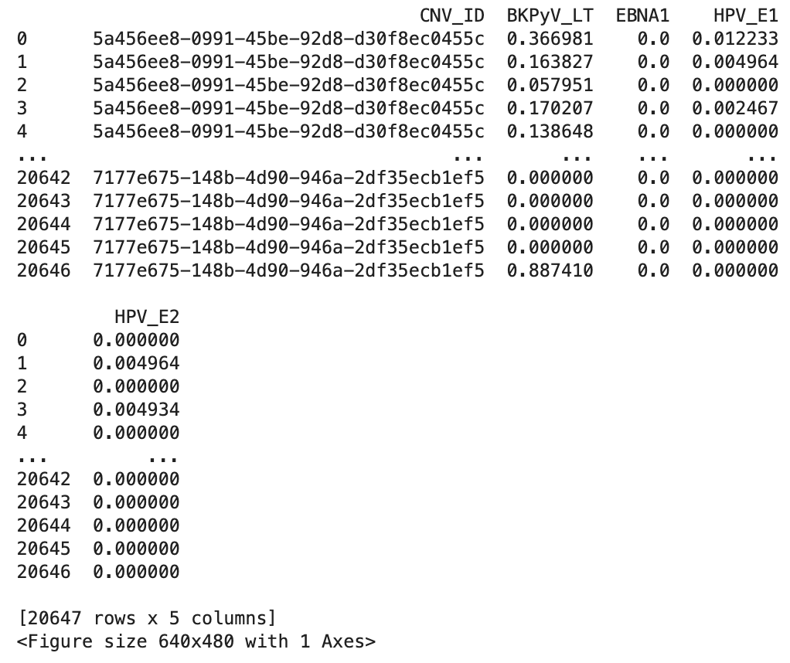
Outputs

Slide 14
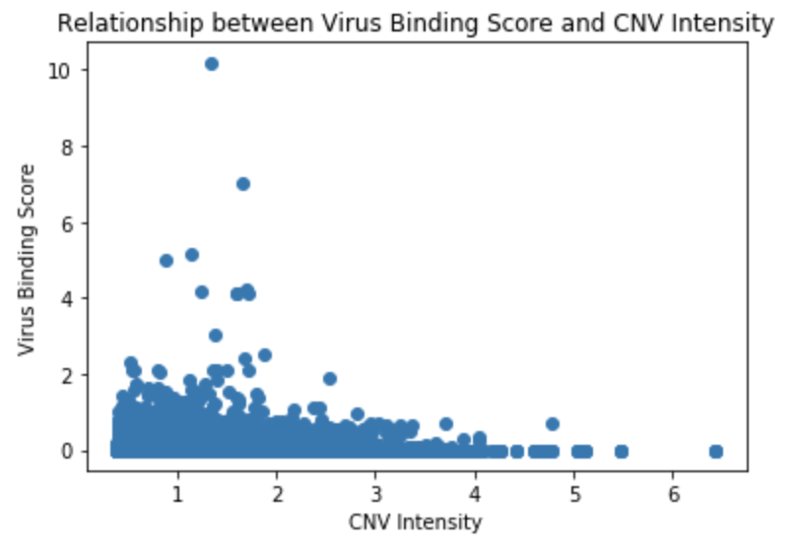
Outputs

Slide 15
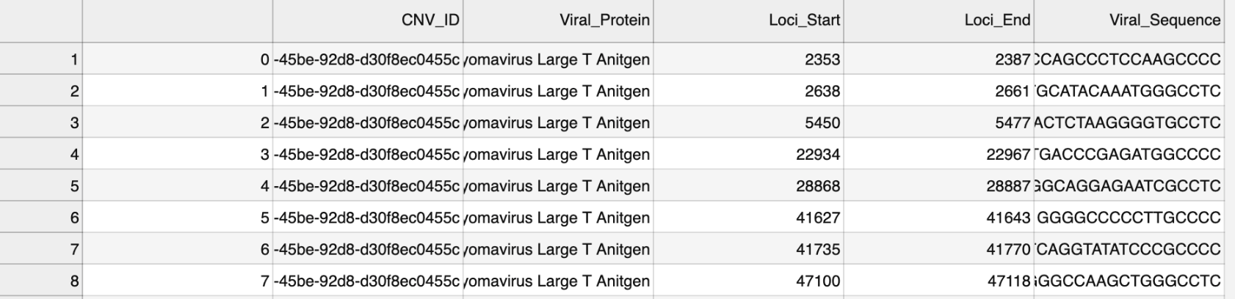
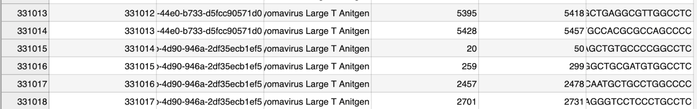
Outputs

